Slide 1
Configuring an EndPoint With Configuration Manager
Team Kilvas:
Brandon Trinkle
Kayla Pollard
Cristian Bachman
Paolo Faso

Slide 2
Introduction to SCCM and Software Deployment
What is SCCM
A Microsoft tool for managing software, OS, and updates across enterprise devices.
How does SCCM deployment work?
Uses task sequences to install applications, updates, or OS remotely.
Benefits of SCCM deployment
Ensures consistency, scalability, and centralized management.
What this presentation covers
Packaging, deploying, troubleshooting, and verifying a task sequence.

Slide 3
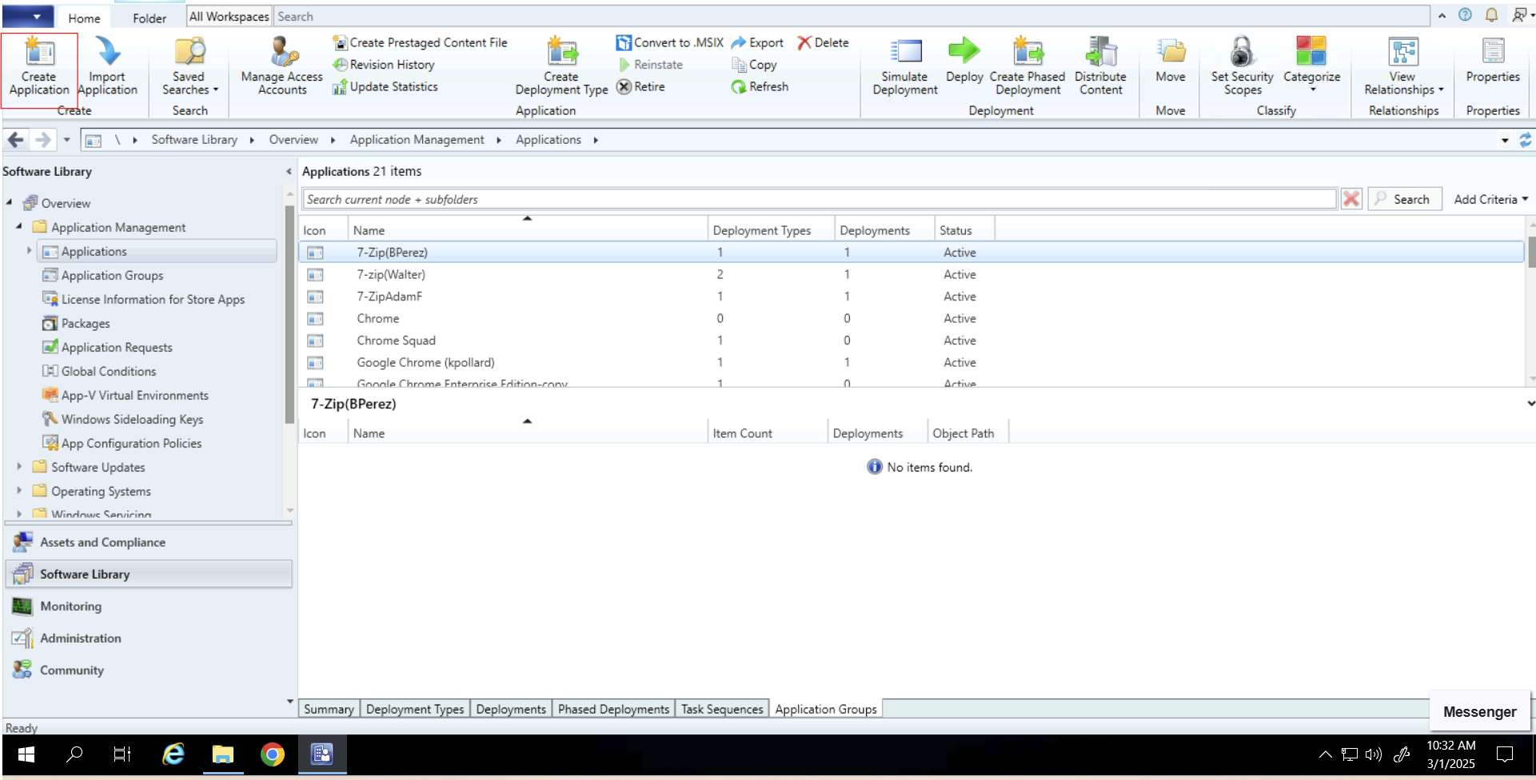
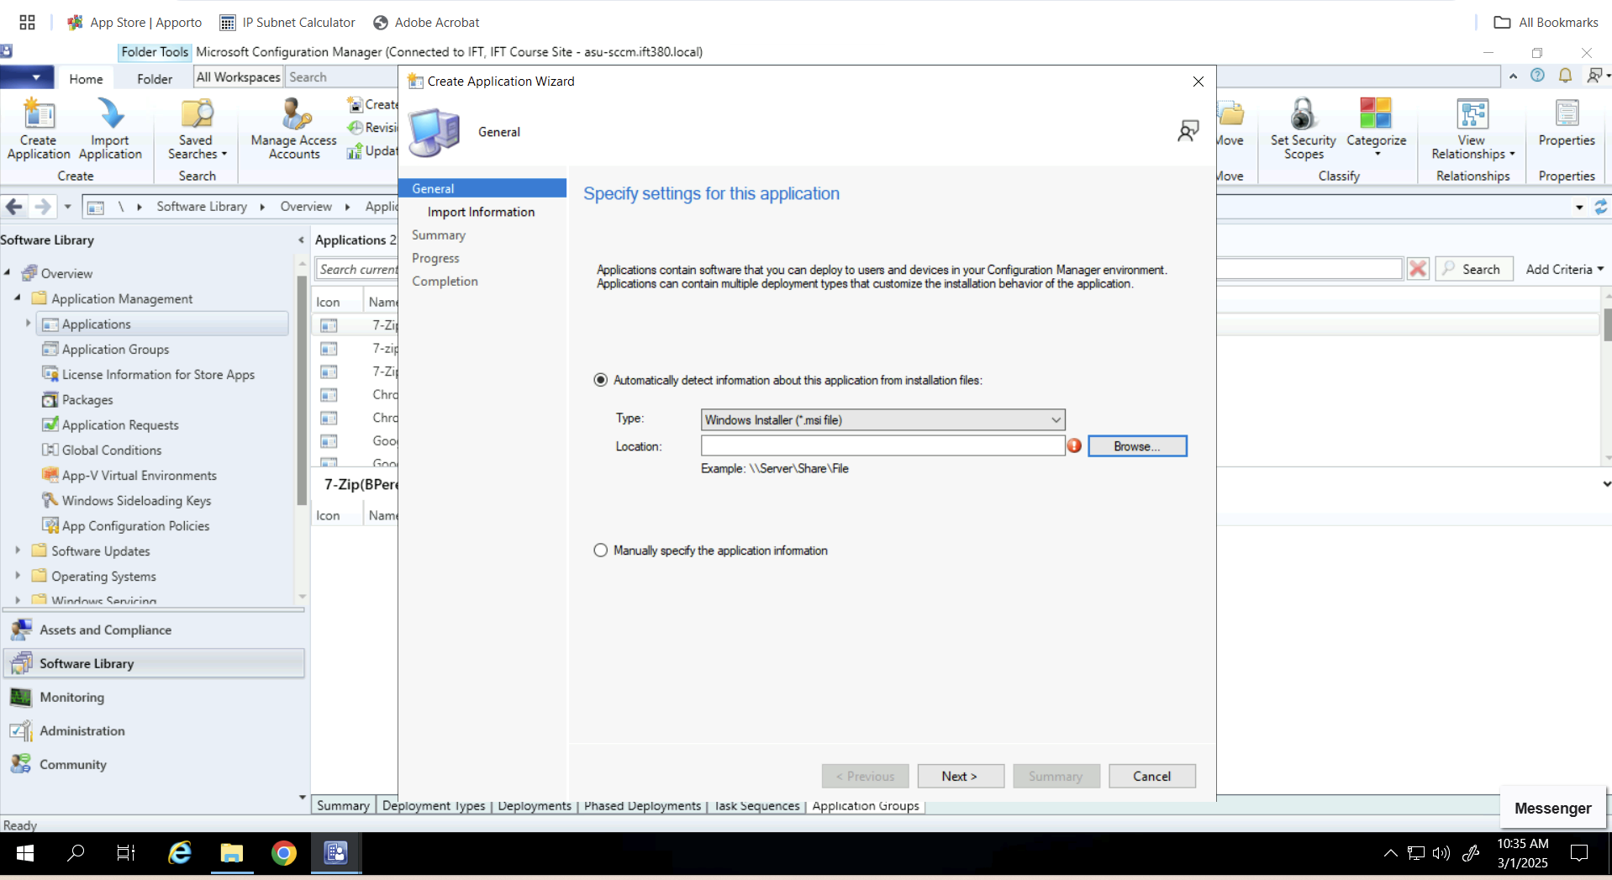
Application Packaging
Create an Application Wizard
Select file installation path

Slide 4
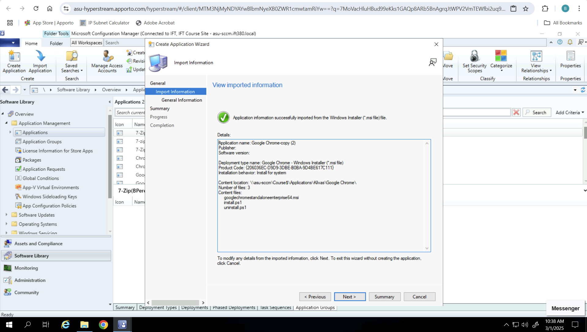
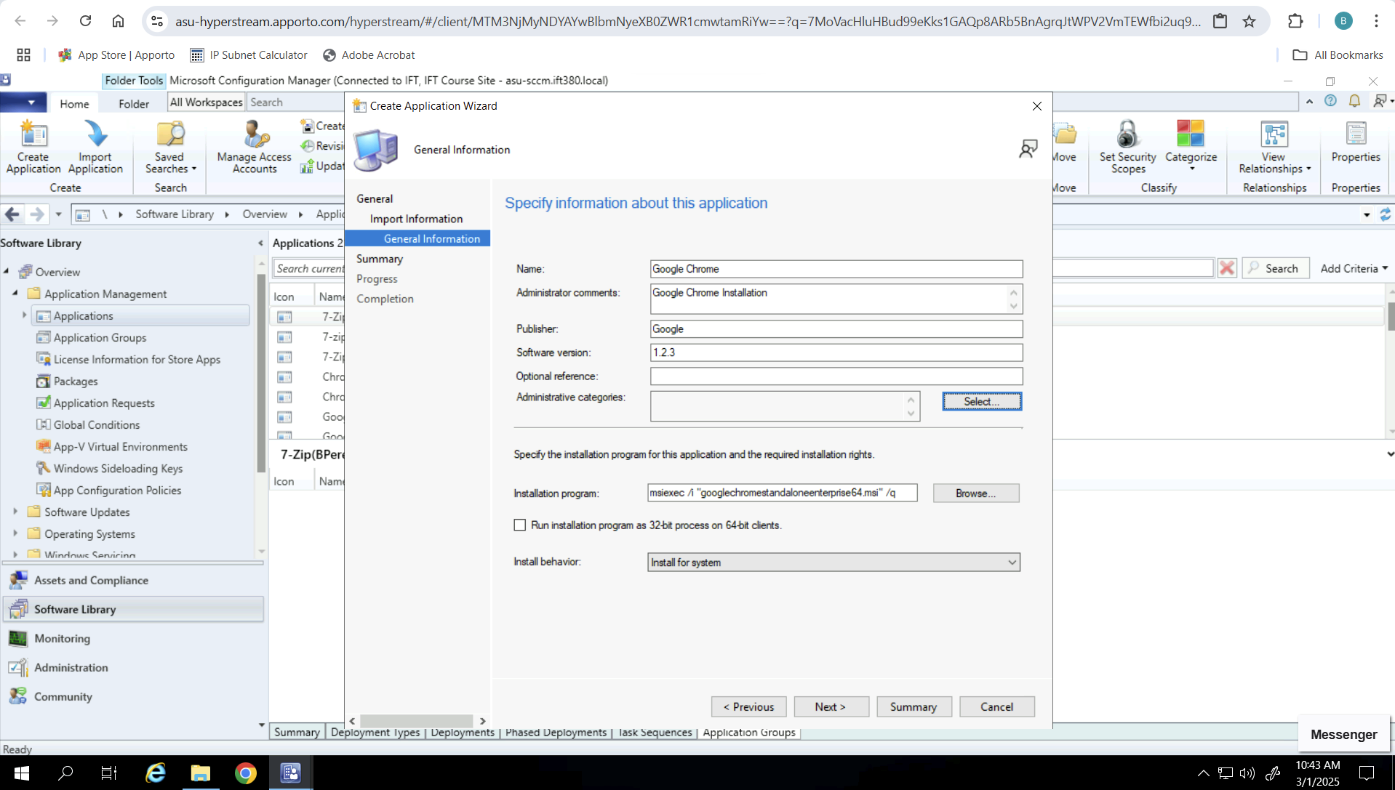
Application Packaging
Confirm Success
Set Package Options

Slide 5
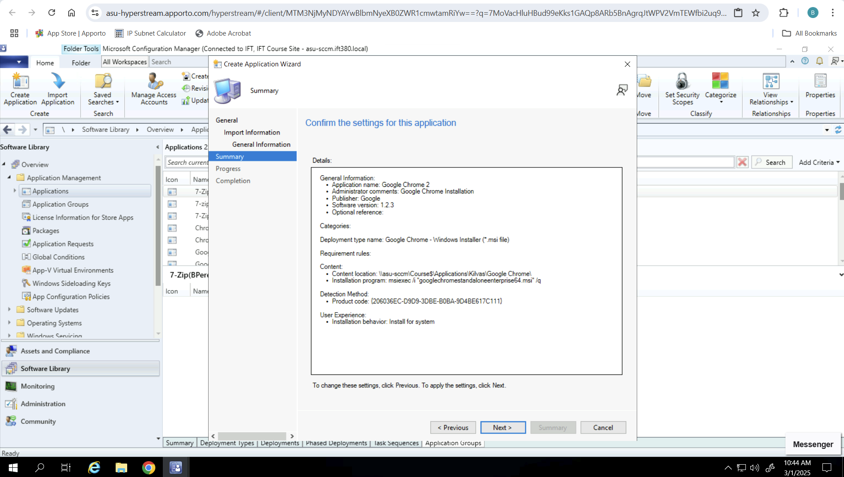
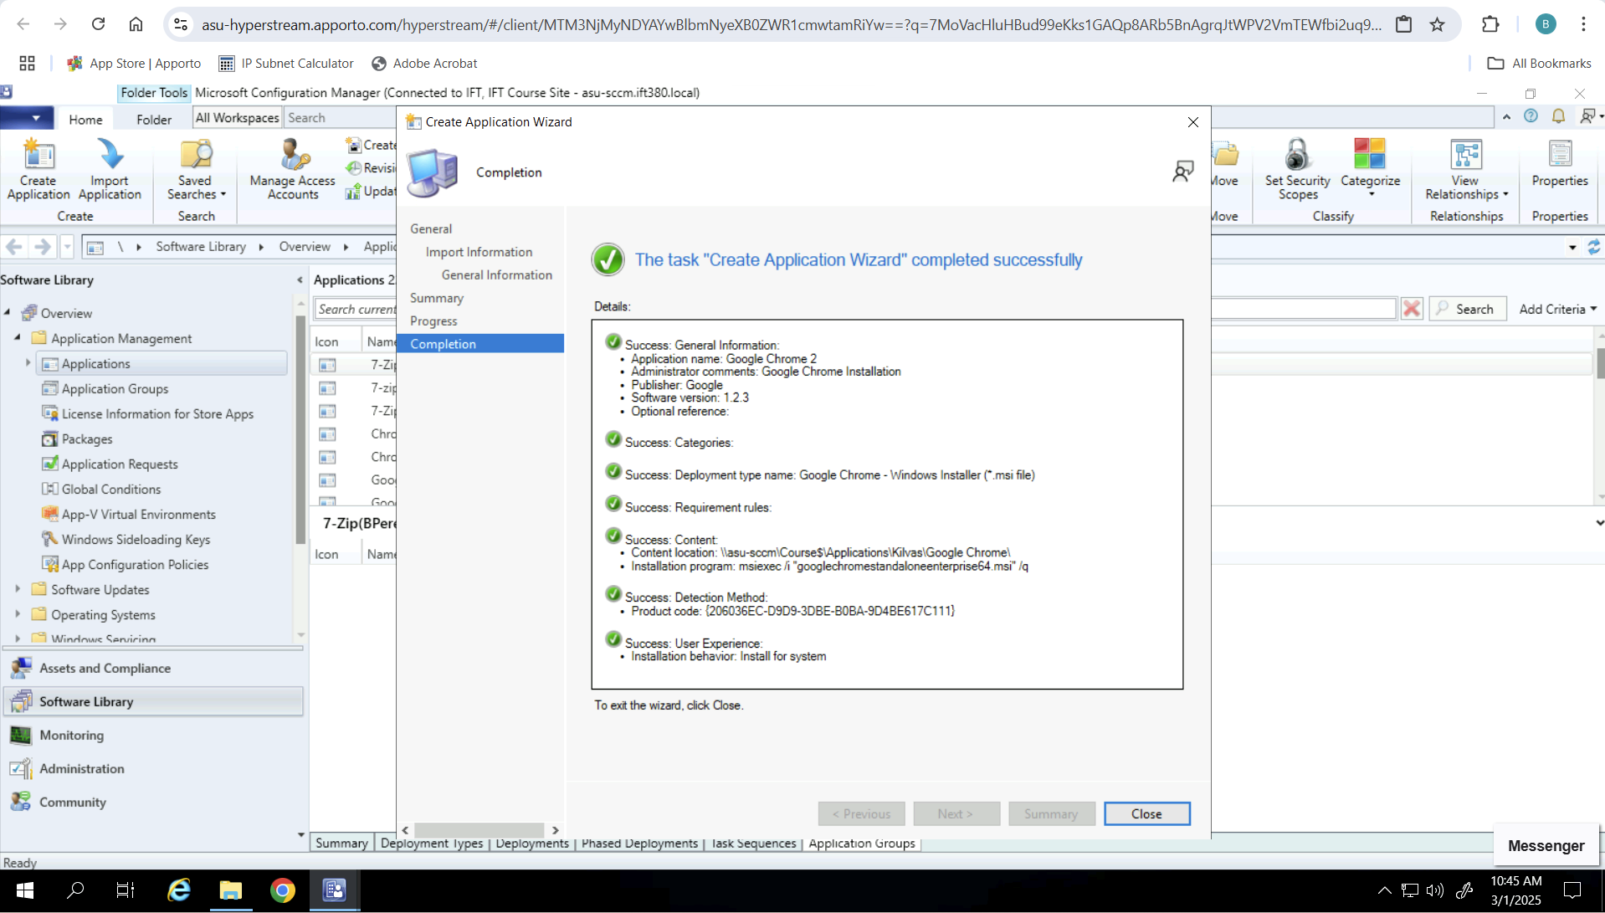
Application Packaging
Confirm Options are Correct
Confirm Package was Successfully Built

Slide 6
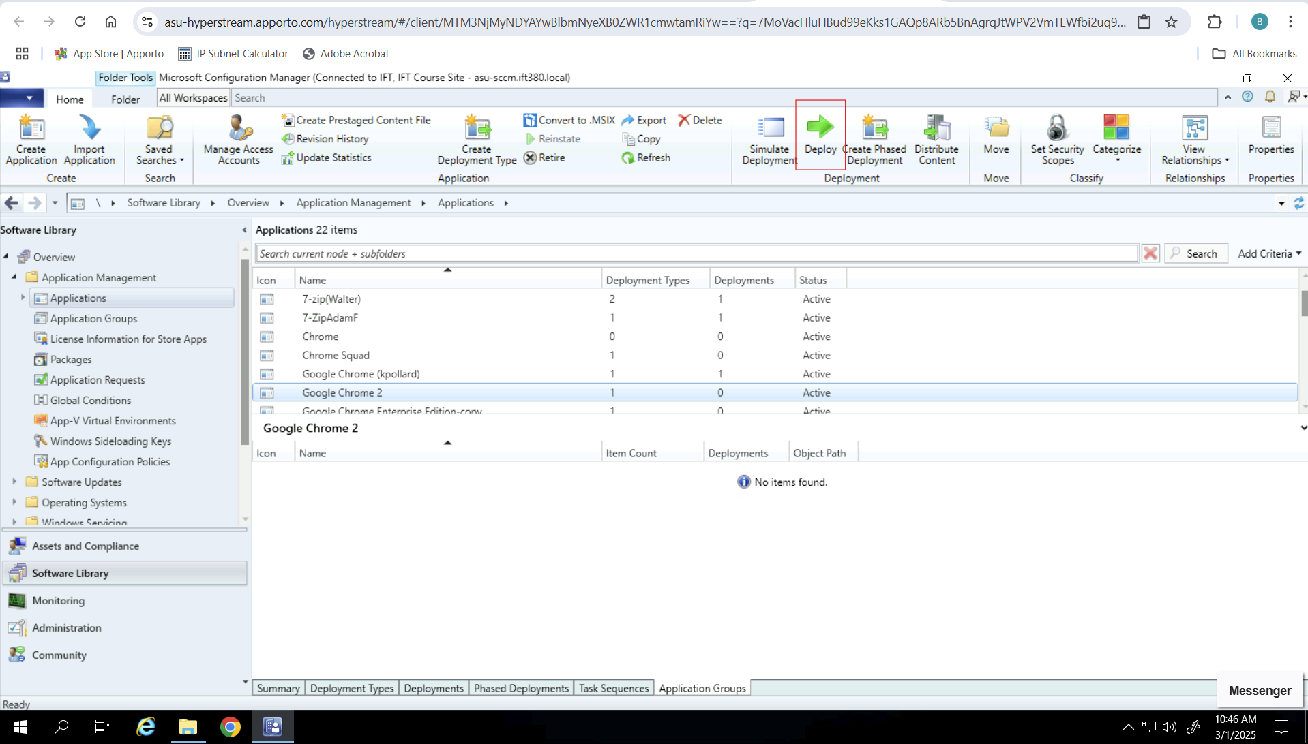
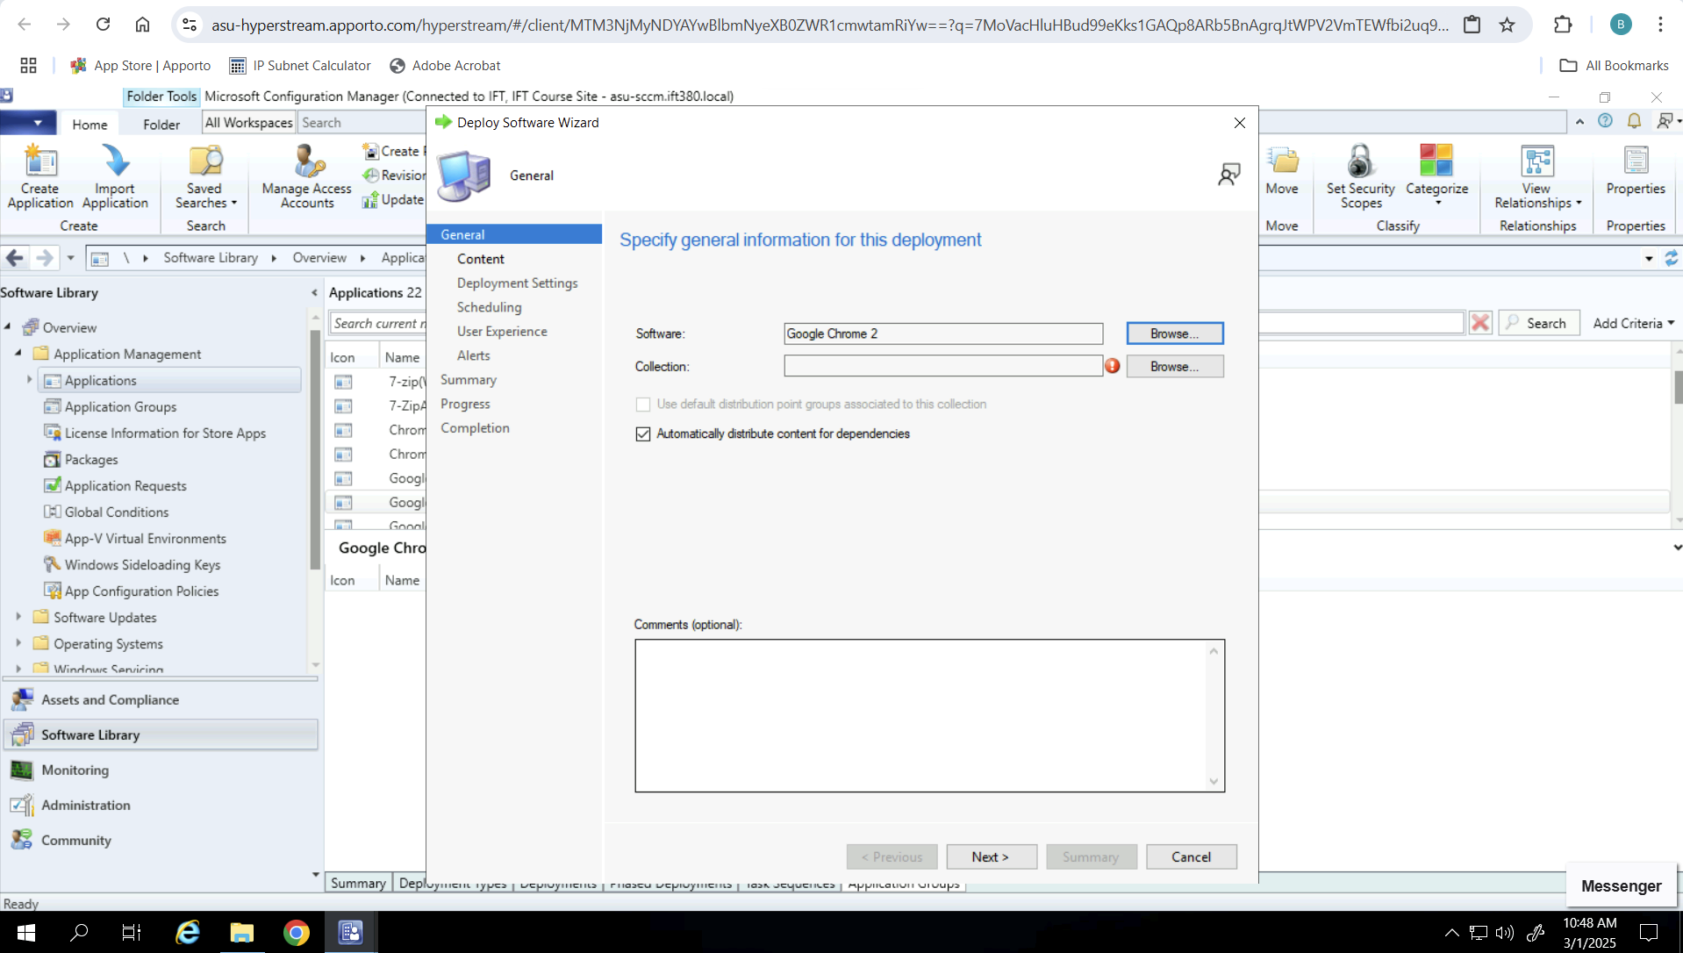
Application Deployment
Create Deployment
Select Target For Deployment

Slide 7
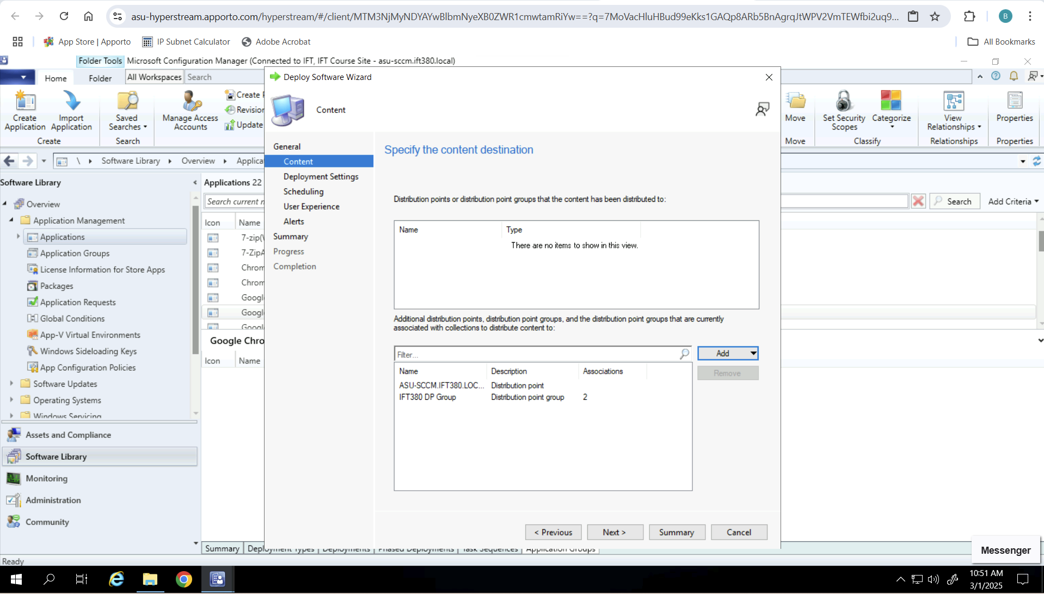
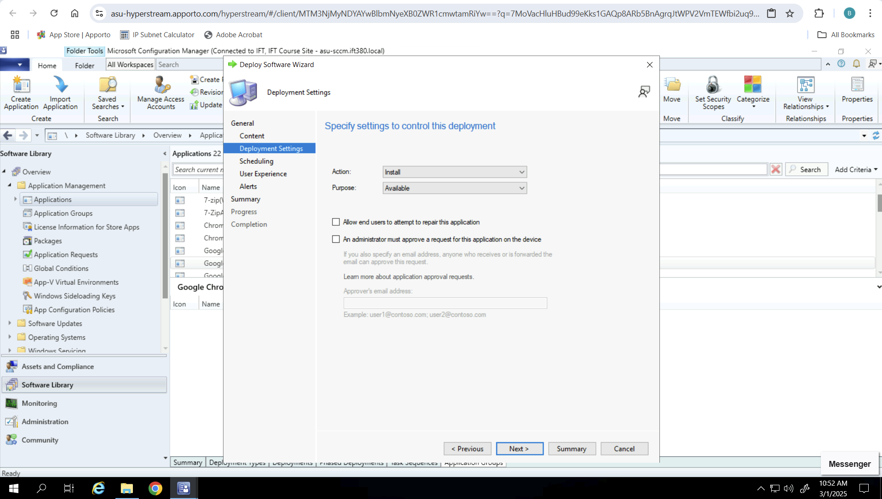
Application Deployment
Select Domain For Deployment
Select Deployment Settings

Slide 8
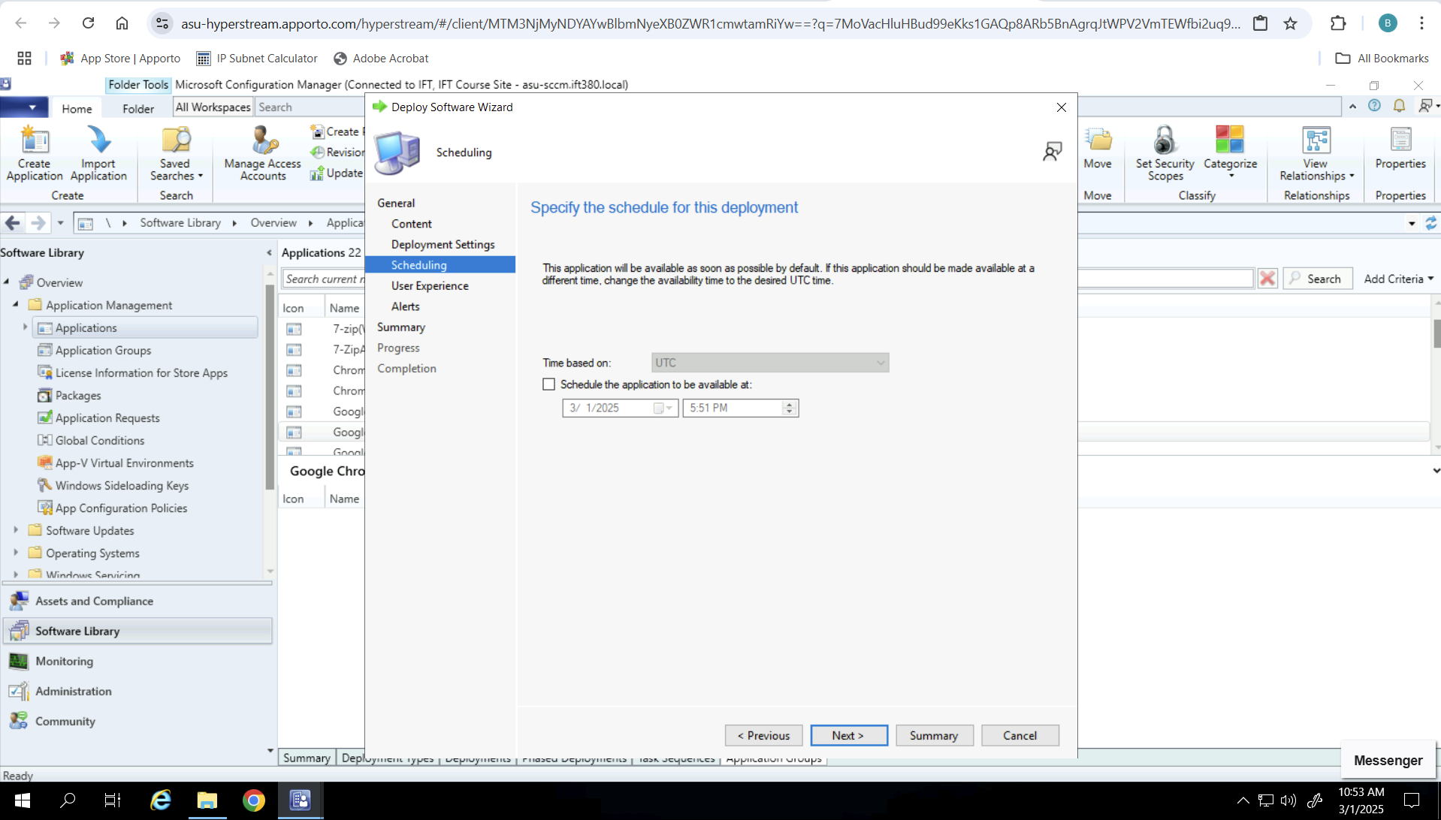
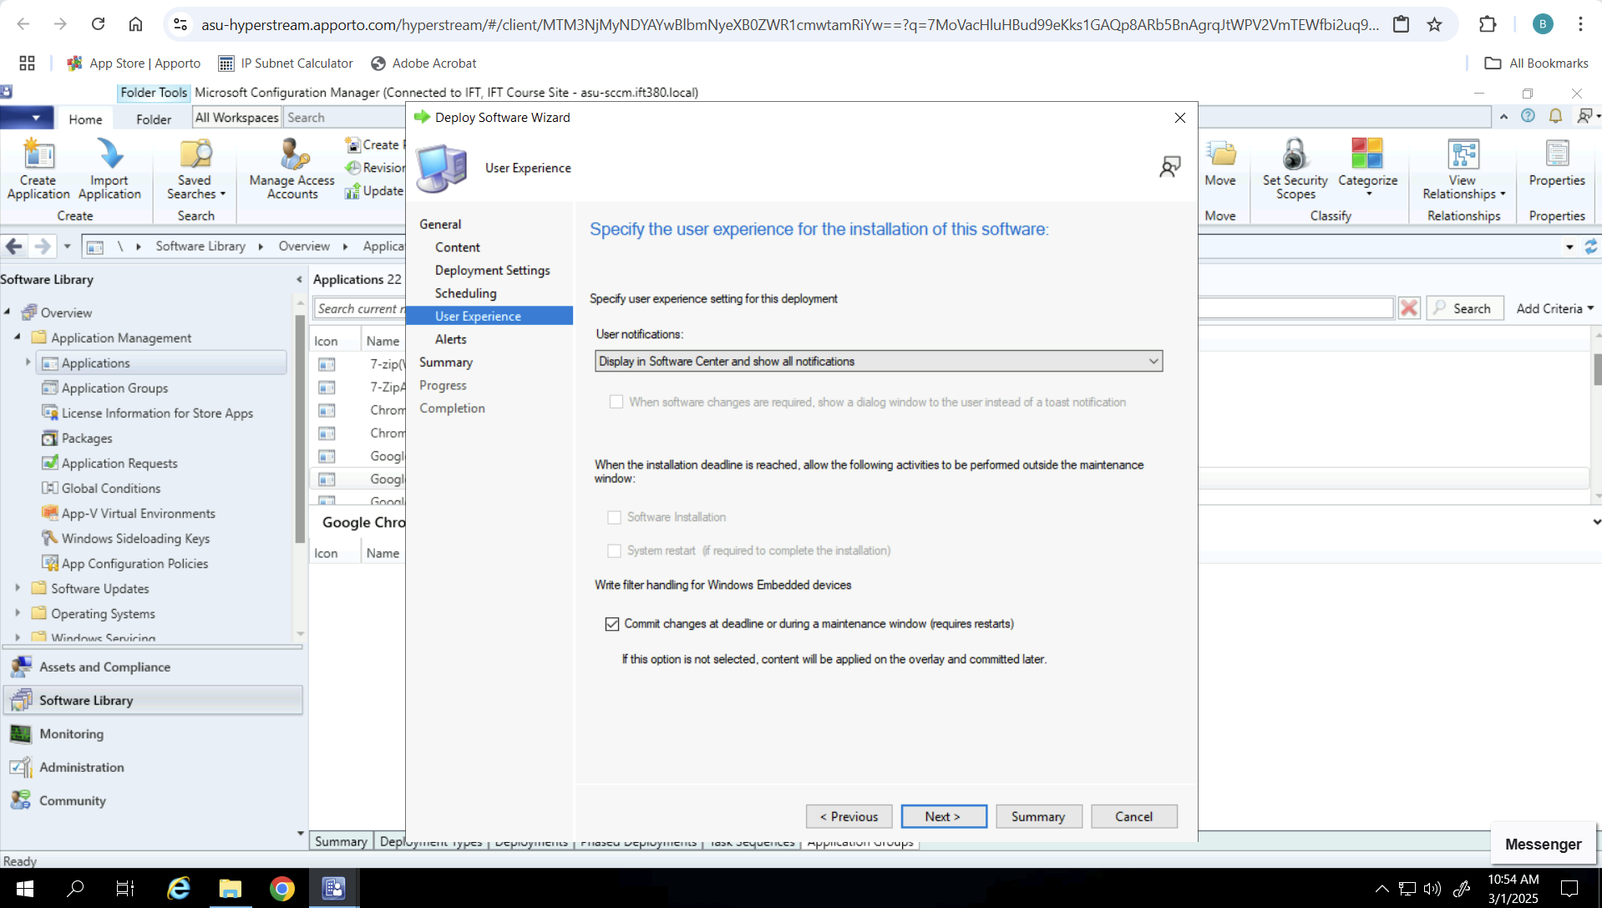
Application Deployment
Select Deployment Schedule
User Experience

Slide 9
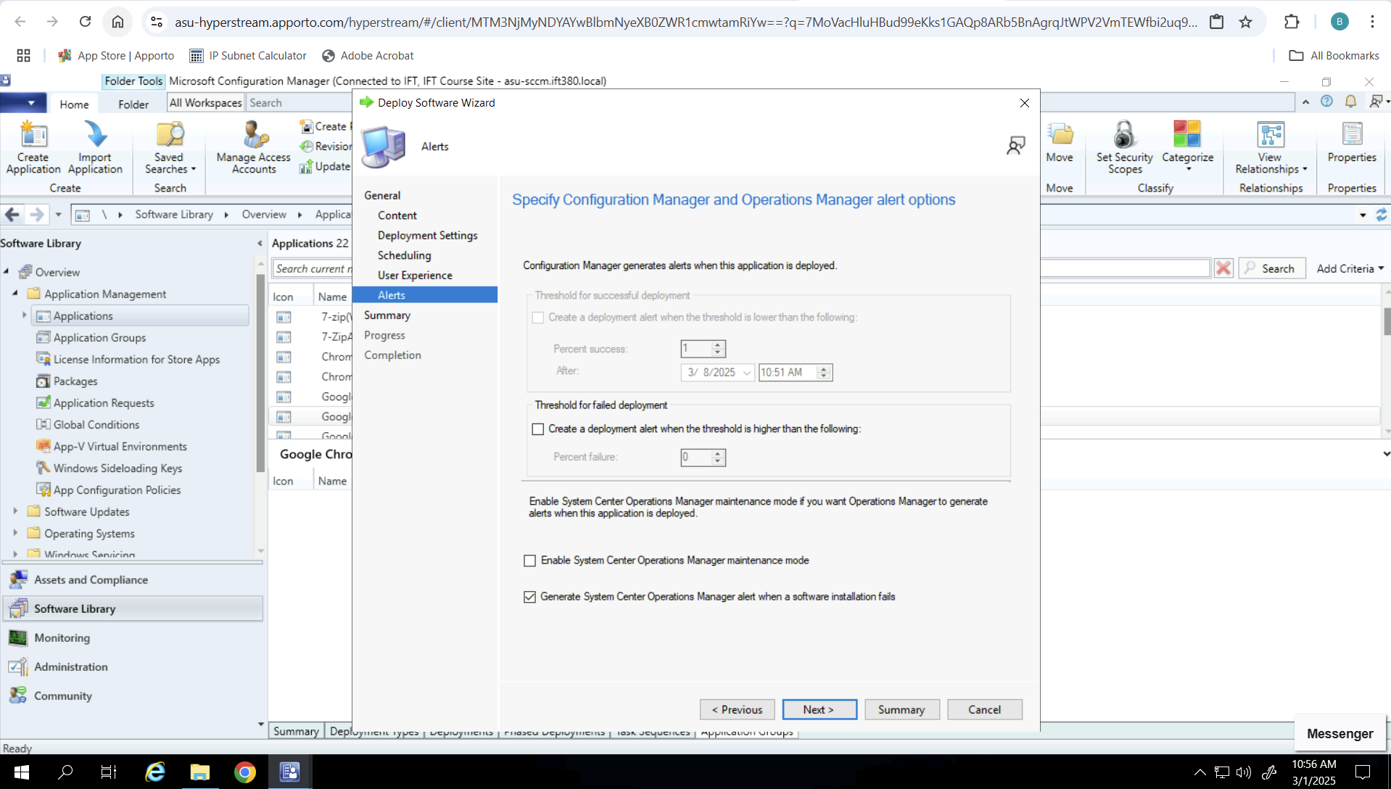
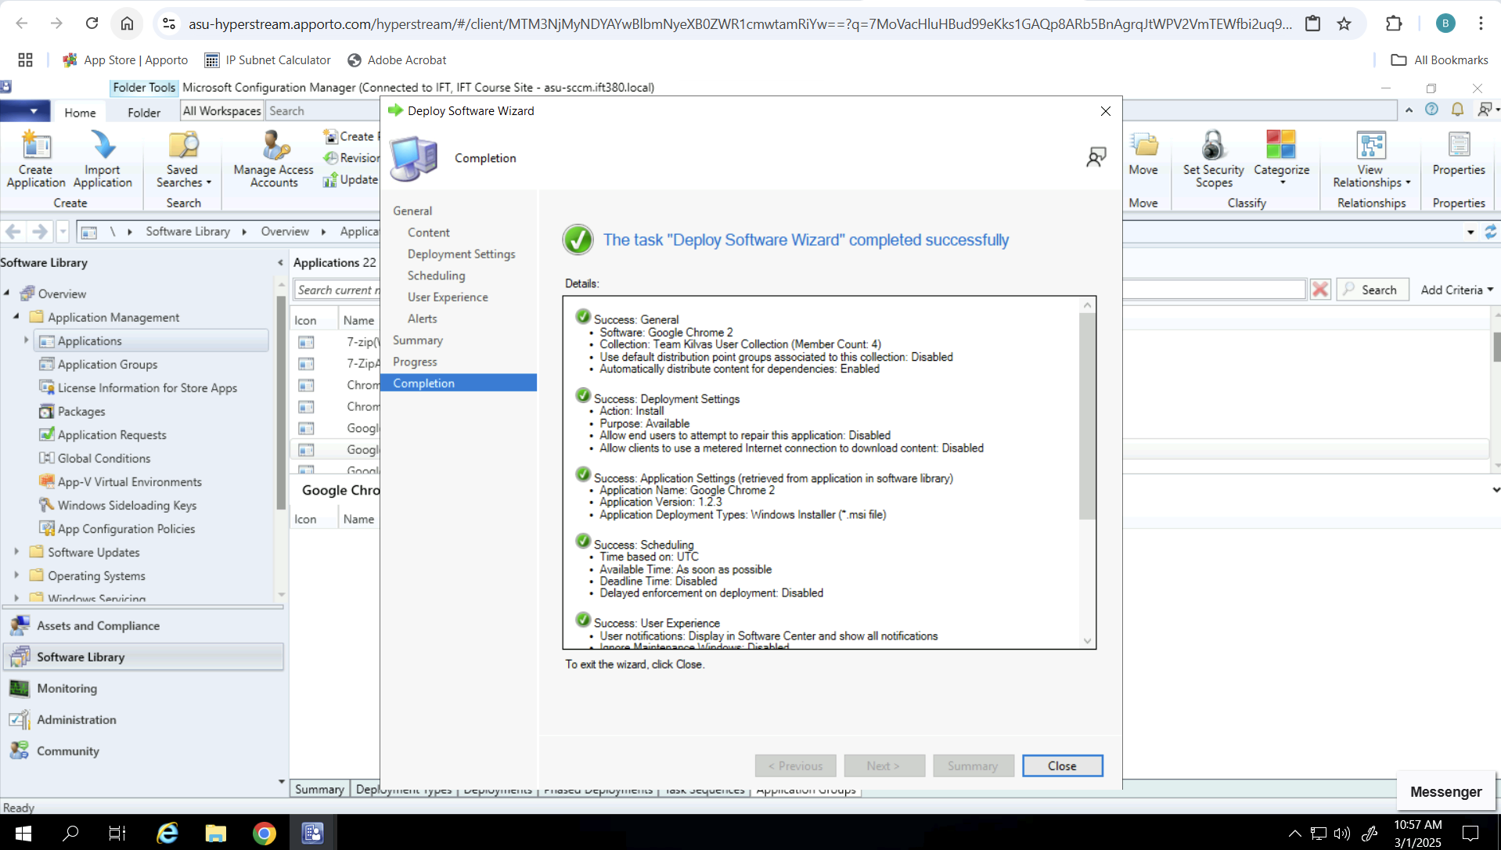
Application Deployment
Select Deployment Alert Notifications
Ensure Success

Slide 10
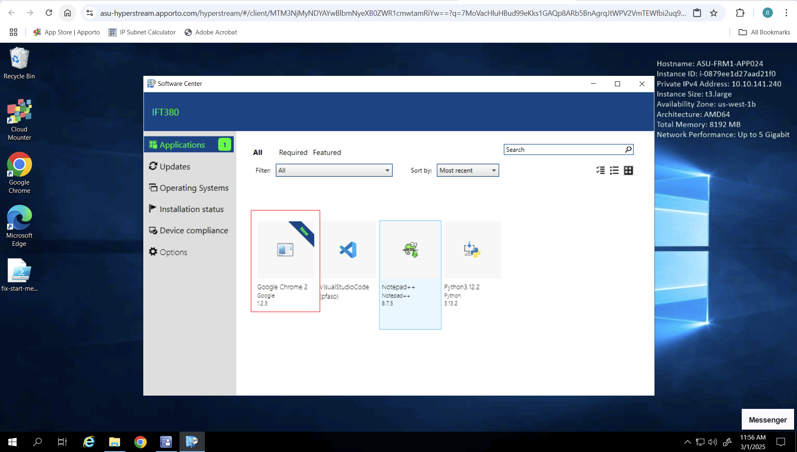
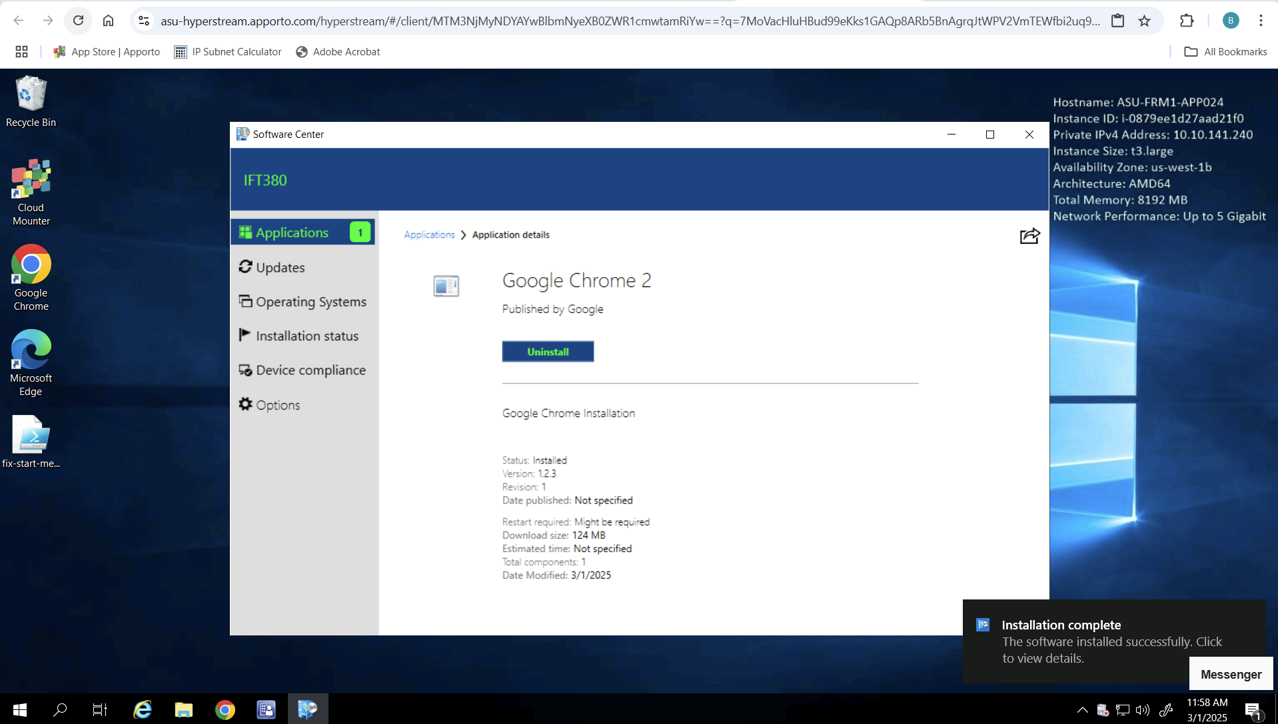
Application Testing
Check Software Center For Deployment
Ensure Installation Success

